Slide 1
Lecture 2
Variational Methods for Image Restoration

Slide 2
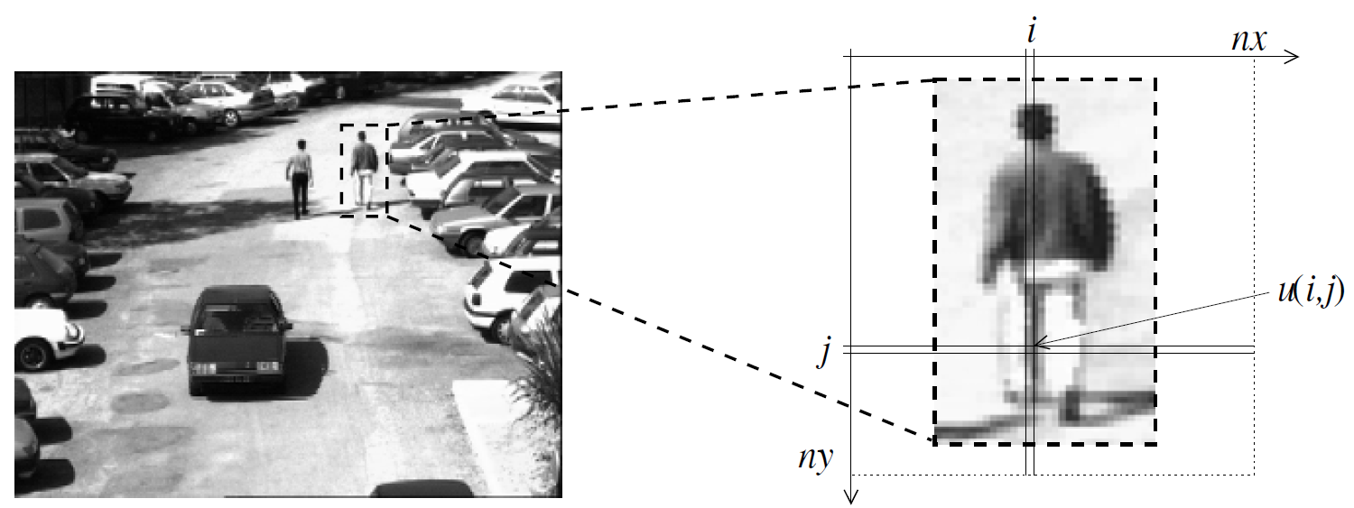
Digital Images
Digital image comes from a continuous world (continuum).
Common pixel representations are unsigned bytes (0 to 255) and floating point.
Image can be vector- or manifold- valued
Quality of digital images: smoothness and sharpness

Slide 3
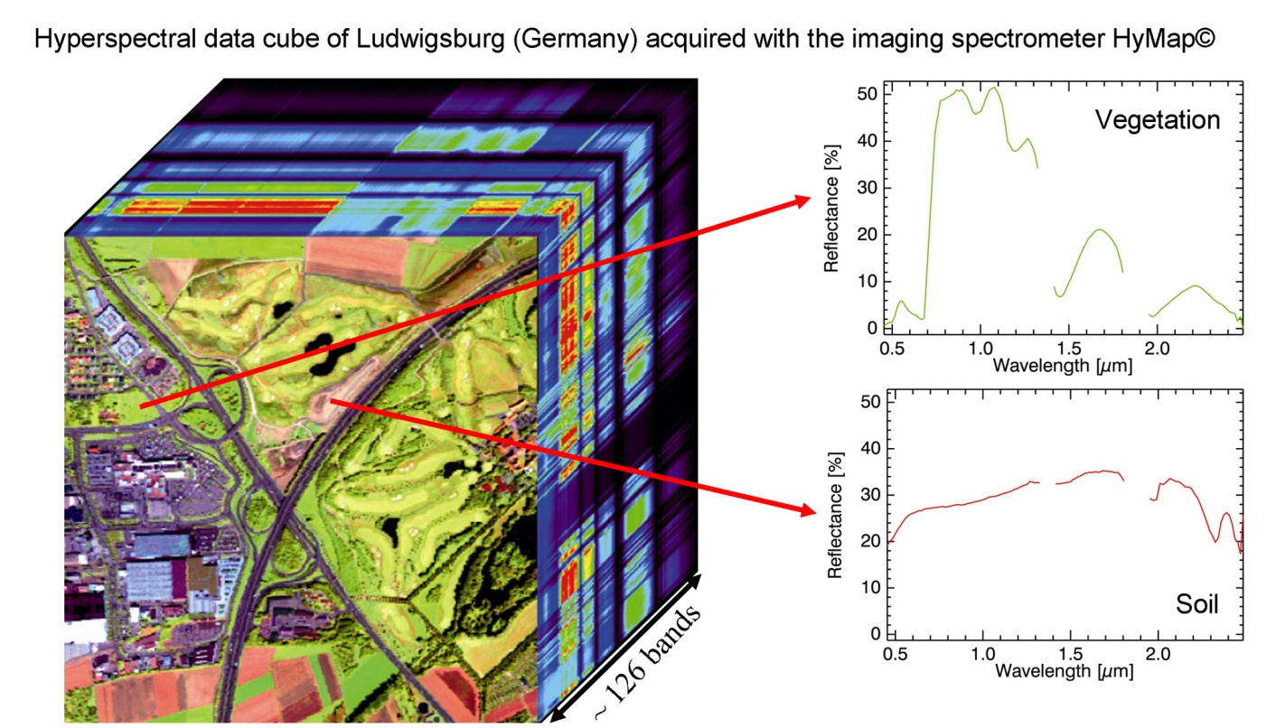
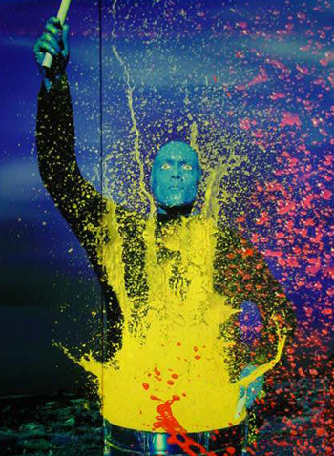
Digital Images
Color Image
Hyperspectral Image

Slide 4
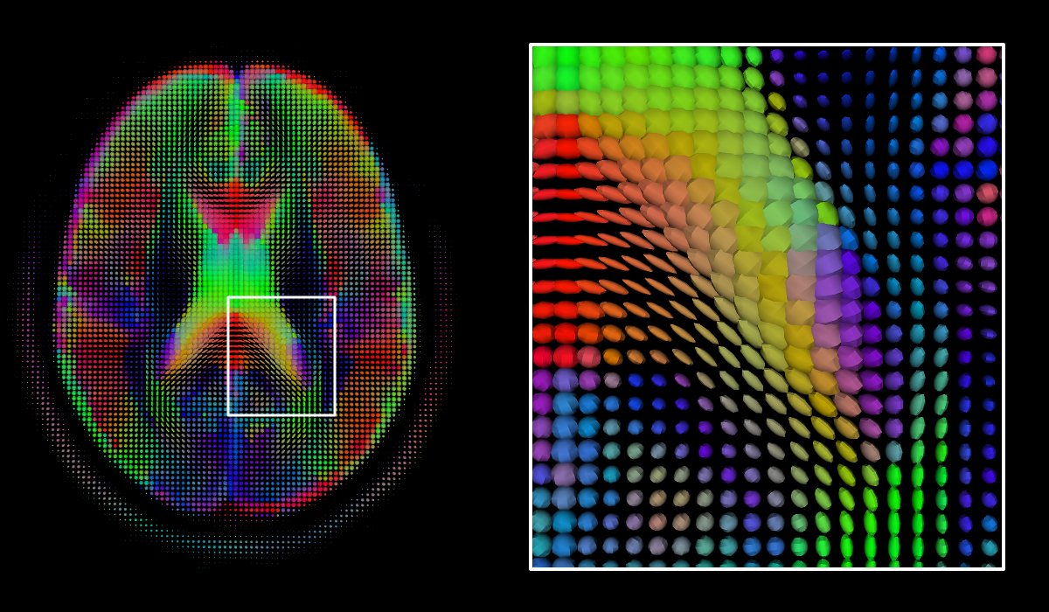
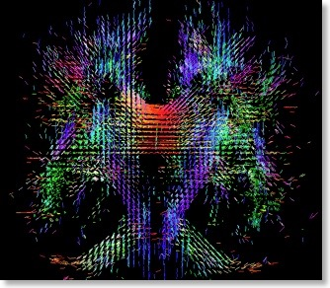
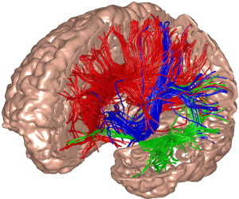
Digital Images
Diffusion Tensor Imaging

Slide 5
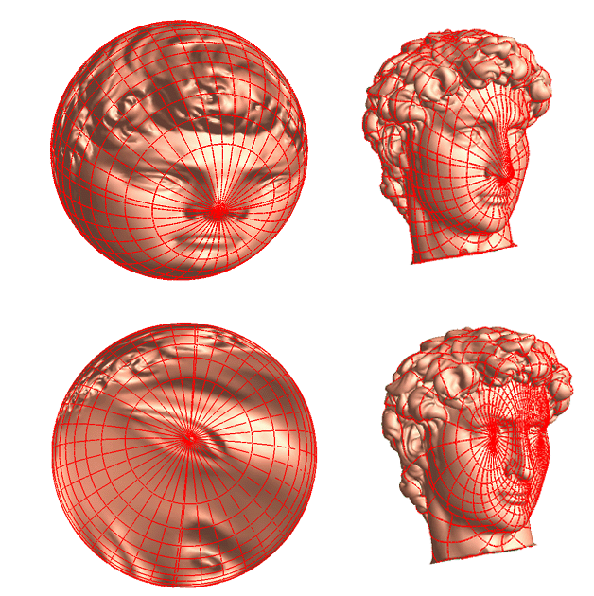
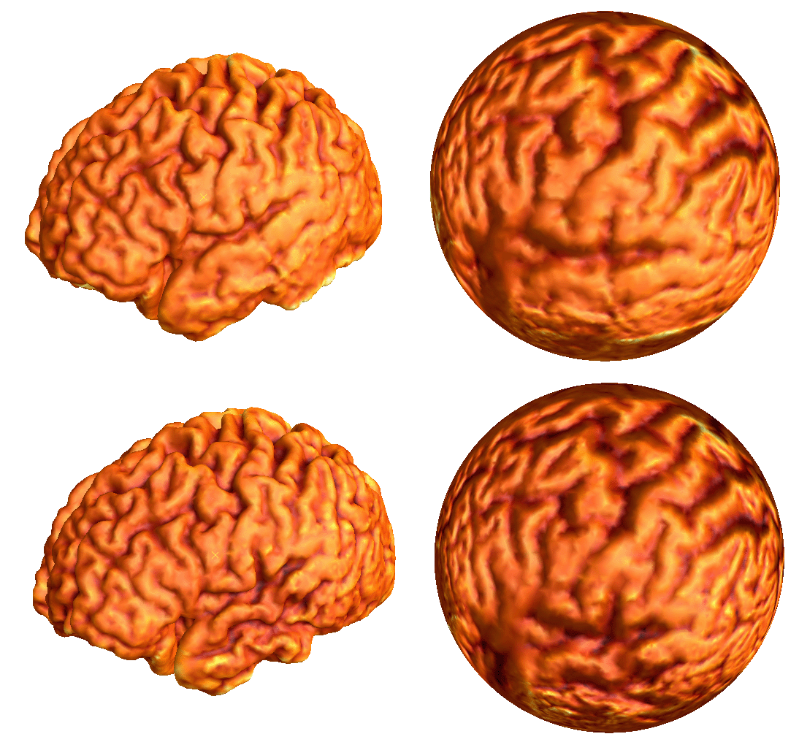
Digital Images
Manifold-Valued Images (gsl.lab.asu.edu)

Slide 6
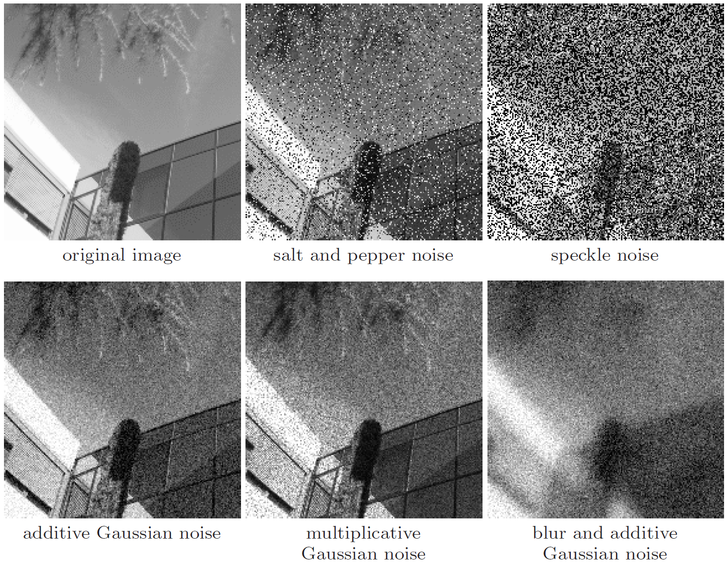
Image Degradation
Noise: Gaussian, gamma (radar images), Poisson (tomography), etc.
Blur: out-of-focus, motion, etc.
Image Restoration

Slide 7
Convex Analysis
A brief introduction

Slide 8
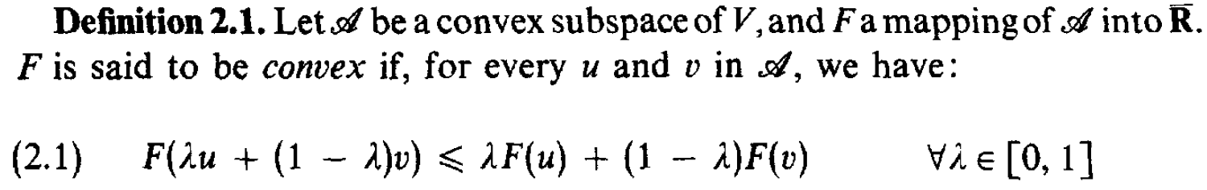
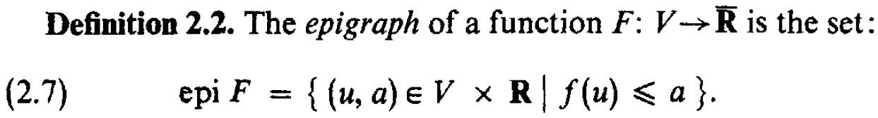
Some Properties from Convex Analysis (Ekeland and Temam, SIAM, 1999)
Convex function on a real vector space V
Epigraph:
Convexity of function and its epigraph:

Slide 9
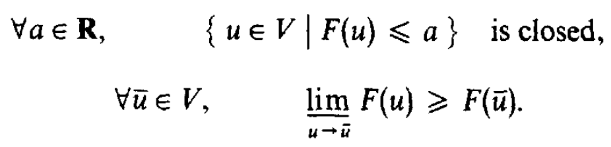
Some Properties from Convex Analysis (Ekeland and Temam, SIAM, 1999)
Lower semi-continuity (l.s.c) if one of the following equivalent conditions is satisfied
Properties l.s.c. functions:
Proper functions: nowhere assumes -infinity and not identical to +infinity.

Slide 10
Some Properties from Convex Analysis (Ekeland and Temam, SIAM, 1999)
Coercive functions
Existence theorem: Given a functional F on a Hilbert space, if F is convex, proper, l.s.c. and coercive, then the minimum of F is attainable by at least one element in the Hilbert space (solution exists). If F is strictly convex, the solution is unique.

Slide 11
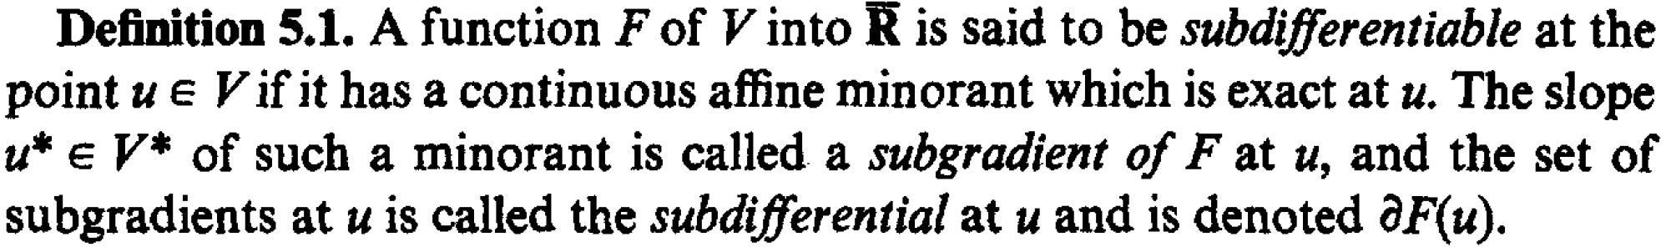
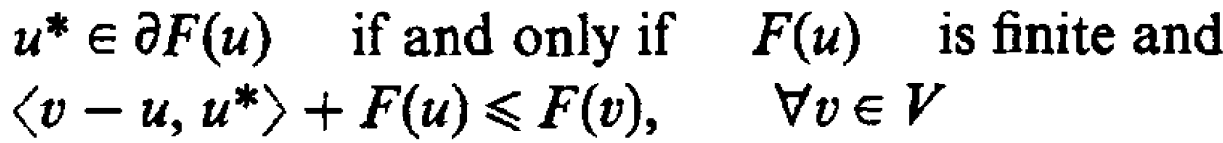
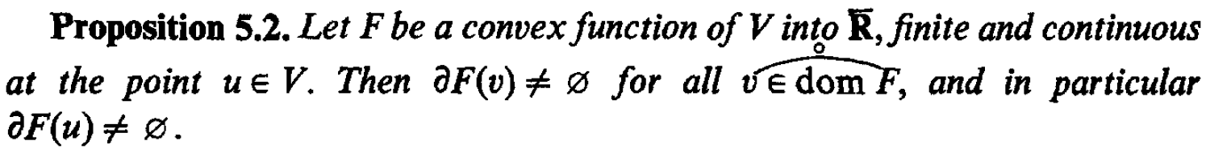
Some Properties from Convex Analysis (Ekeland and Temam, SIAM, 1999)
Subdifferential
Properties of subdifferentials
Inequality characterization
Optimality (Fermat’s Theorem)
Convex functions are (almost) always subdifferentiable

Slide 12
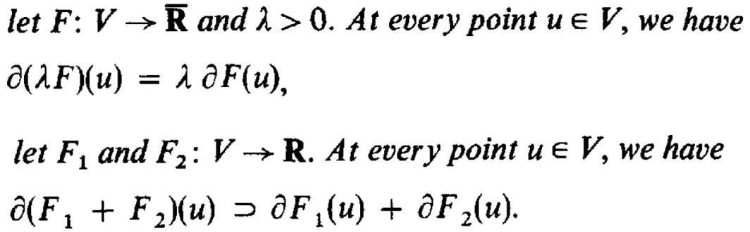
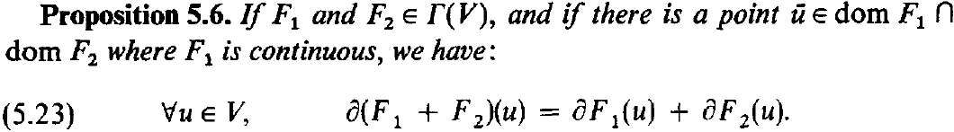
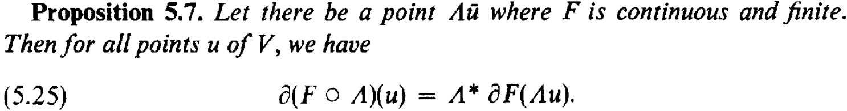
Some Properties from Convex Analysis (Ekeland and Temam, SIAM, 1999)
Subdifferential calculus:
Chain Rule

Slide 13
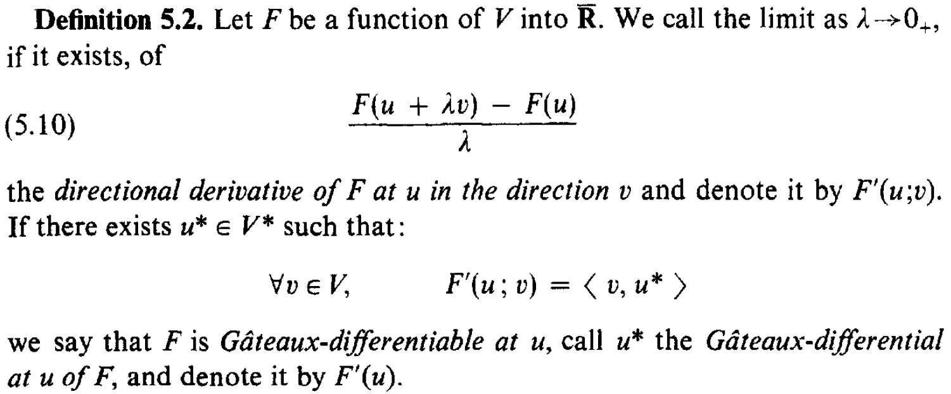
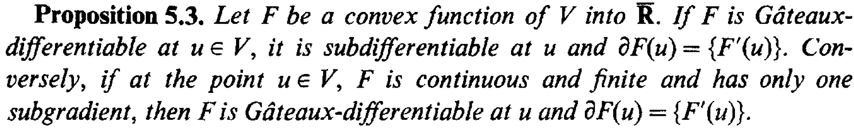
Differentiations of Functionals
Gateaux differential
Relation with subdifferential

Slide 14
Least Square and an Example from DNA Sequencing
Least squares do not work well in practice

Slide 15
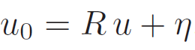
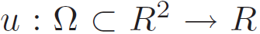
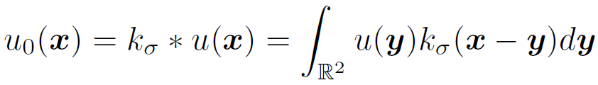
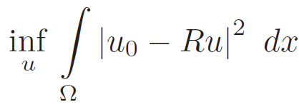
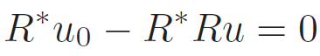
Formulation for Image Restoration
Linear inverse problem
Where and R is some linear operator, e.g. convolution operator for blurs.
Objective: solve for u.
Straightforward model: least-squares
Normal equation (equation of critical point):
Example:
Not a good idea!

Slide 16
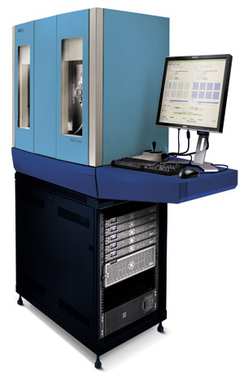
Example: Image Processing in DNA Sequencing (SOLiDTM DNA Sequencer)
DNA: 3 Billion Letters
Sample
Slide

Slide 17
Schematic of Sequencing Method
…
…
DNA
Fragment
Attach to beads
Replicate on
bead

Slide 18
Schematic of Sequencing Method, Continued
Attach beads
to surface
surface
Do Sequence Reading Chemistry:
Dye/Letter Color Code: A/C/G/T
Cycle i = 1...N ~ 50
cycle
…
6
5
i=4
3
2
1
surface
Cycle i Imaging:
4 mono-color
Images
Blue Filter (A)
Green Filter (C)
Orange Filter (G)
Red Filter (T)
Next
cycle
+ Cycle i Letter Calling Spot 1 @ i = T Spot 4 @ i = G Spot 3 @ i = C Spot 2 @ i = A

Slide 19
Real Images
Cycle 1: 4 mono-color images
Purpose: To read the 4 letters
A/C/G/T at letter position 1 on DNA
Signal from
A Dye (FTC)
Signal from
C Dye (Cy3)
Signal from
G Dye (TXR)
Signal from
T Dye (Cy5)
… repeat …
…
Cycle 50: 4 mono-color images
To read the 4 A/C/G/T
Purpose: To read the 4 letters
A/C/G/T at letter position 50 on DNA
Signal from
A Dye (FTC)
Signal from
C Dye (Cy3)
Signal from
G Dye (TXR)
Signal from
T Dye (Cy5)

Slide 20
Key: Image Processing
Find the location of each bead
Find the image intensity of each bead
Difficulties:
Blur
Noise

Slide 21
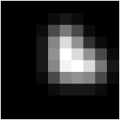
Finding Beads’ Centers and Intensities
2D Array
Image with 3 beads
0 0 0 0 0 0 0 0 0 0
0 0 0 0 1 2 1 0 0 0
0 0 0 1 6 10 6 1 0 0
0 0 0 2 11 18 12 4 1 0
0 0 0 2 12 21 18 12 6 1
0 0 0 2 11 20 21 18 10 2
0 0 0 1 6 11 12 11 6 1
0 0 0 0 1 2 2 2 1 0
0 0 0 0 0 0 0 0 0 0
0 0 0 0 0 0 0 0 0 0

Slide 22

Finding Beads’ Centers and Intensities
Correct solution
Correct solution
0 0 0 0 0 0 0 0 0 0
0 0 0 0 0 0 0 0 0 0
0 0 0 0 0 0 0 0 0 0
0 0 0 0 0 16 0 0 0 0
0 0 0 0 0 0 0 0 0 0
0 0 0 0 0 16 0 16 0 0
0 0 0 0 0 0 0 0 0 0
0 0 0 0 0 0 0 0 0 0
0 0 0 0 0 0 0 0 0 0
0 0 0 0 0 0 0 0 0 0

Slide 23
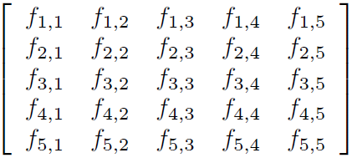
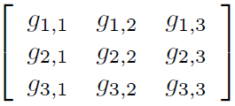
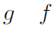
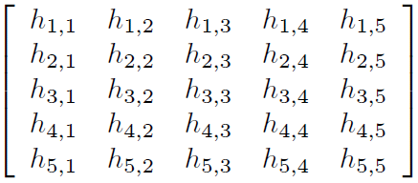
Modeling as Deblurring with Circular Convolution
Image
Convolution Kernel

Slide 24
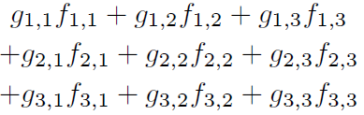
Circular Convolution: Interior
Image
Convolution Kernel

Slide 25
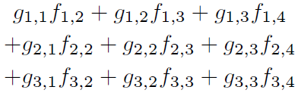
Circular Convolution: Interior
Image
Convolution Kernel

Slide 26
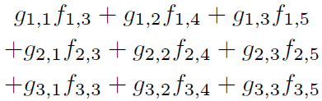
Circular Convolution: Interior
Image
Convolution Kernel

Slide 27
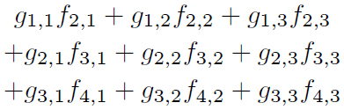
Circular Convolution: Interior
Image
Convolution Kernel

Slide 28
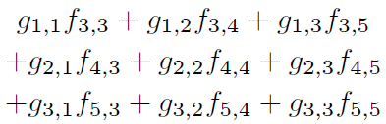
Circular Convolution: Interior
Image
Convolution Kernel

Slide 29
Circular Convolution: Boundary
?
?
?
Convolution Kernel
?
?

Slide 30
Circular Convolution: Boundary
?
?
?
Convolution Kernel

Slide 31
Circular Convolution: Boundary
Convolution Kernel
?
?
?

Slide 32
Circular Convolution: Boundary
Convolution Kernel
?
?
?
?
?

Slide 33
Periodic Boundary Extension

Slide 34
Periodic Boundary Extension
Extension Radius=(size of kernel-1)/2=1

Slide 35
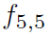
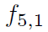
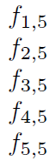
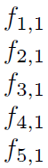
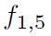
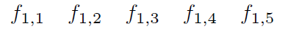
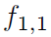
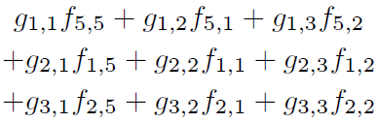
Circular Convolution: Boundary
Image
Convolution Kernel

Slide 36
Circular Convolution: Boundary
Image
Convolution Kernel
Similarly

Slide 37
Circular Convolution: Boundary
Image
Convolution Kernel
Similarly

Slide 38
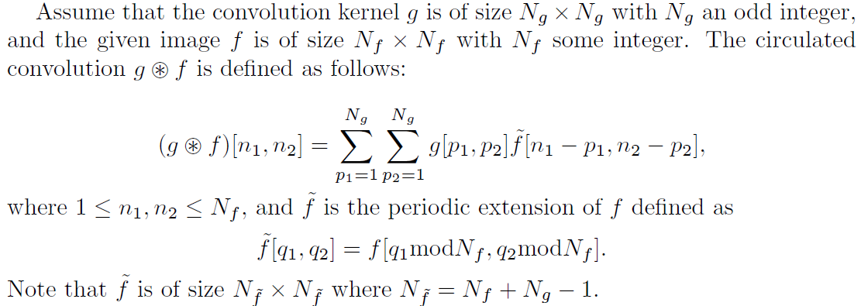
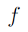
Circular Convolution: Mathematical Formula
…
…
…
…
…
…
…
…
…
…
…
…

Slide 39
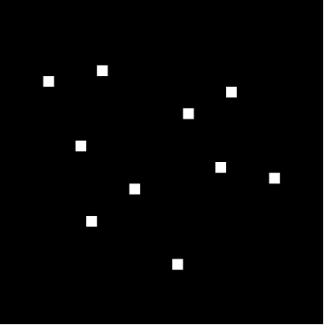
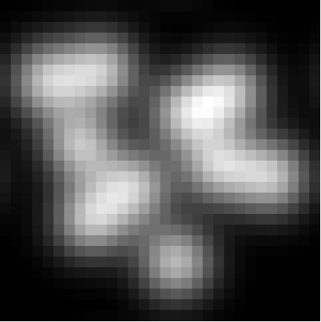
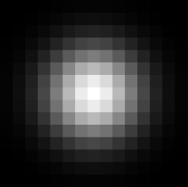
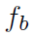
Back to Our Problem
Bead centers and intensities
Image we have
Shape of bead
Known
or can be
estimated
Wanted
Known

Slide 40



Deblurring Problems
Finding image from the observed image
is called image deblurring
We need to invert the operation and somehow obtain from , i.e.
Question: What is ?

Slide 41




Understand images as vectors in Euclidean Space: Vectorization
C1
C2
C1
C2
C3
C4
C5
Note: In MATLAB, converting an image to or from it’s
corresponding vector version can be done by the function “reshape”
C5

Slide 42







Understand as A Linear Transformation in
From definition, it is easy to show that is linear
Then by theory of linear algebra, can be realized as matrix multiplication, i.e. let be the corresponding matrix, we have
where is the vectorized version of
Therefore, solving

Slide 43


How to Represent ?
From the definition of circulated convolution and the rule of vectorization. Computationally efficient.
Using theory of linear algebra. Easy to do analysis.

Slide 44


Solving the Linear System: Noise Free
Bead centers and intensities
Image we have
Shape of bead
Known
Wanted
Known

Slide 45

Solving the Linear System: Noise Free
Solving the linear system, we have
Solution looks exactly right!

Slide 46


Solving the Linear System: Noisy
In practice, the observed image is usually corrupted by noise


+
=
Noise

Slide 47
Solving the Linear System: Noisy
In practice, the observed image is usually corrupted by noise
Magnitude0.04
Magnitude0.004


Noise

Slide 48

Solving the Linear System: Noisy
If we solve the linear system below, we get
Magnitude
10,000
Solution is not even close…

Slide 49


How Did This Happen?
Although is invertible, it is very close to singular, which means its smallest eigenvalue is very close to zero.
Therefore, the operation greatly amplifies the vector .
For Example:

Slide 50


How Did This Happen?
What we did to find was as follows:
Therefore, directly solving the linear system at the presents of noise is a bad idea …
Actual Solution
Error (BIG ONE)

Slide 51




Ill-Posed Problems
In general solving when is, or close to, singular is call an ill-posed problem
The “badness” of the problem is measured by the condition number of matrix defined as
The condition number of any matrix is always ≥1. The bigger is the condition number, the worse (or difficult) is the problem

Slide 52
Regularizations
Solving ill-posed problems

Slide 53



Regularization - Tikhonov and Arsenin, 1977
Need regularization when solving
Minimization of the following functional
Minimization takes place in the following space
Has unique solution when R is continuous and R(1) is not zero.
EL equation:
Still not ideal for images: too much smoothing

Slide 54

Regularization - Tikhonov and Arsenin, 1977

Slide 55


Total Variation
Definition of total variation

Slide 56




Total Variation
Properties of BV:
Banach space (but not reflexive)
Trace is well defined
Weak*-topology: every uniform bounded sequence has weak*-convergent subsequence
BV semi-norm is weak* lower semicontinuous

Slide 57



Total Variation
Decomposition of a BV function (L. Ambrosio, 1989):

Slide 58



Total Variation
Rudin-Osher-Fatemi (ROF) 1992
BV semi-norm
Euler-Lagrange (formally)
Notes:
Difference between BV and W_2^1

Slide 59
Total Variation
Existence of solutions of ROF model: The ROF model
has a unique solution in BV provided that
which implies that the ROF functional is BV-coercive.
Keys to the proof:
Convergence (in proper topology) of minimizing sequence;
Low semicontinuity (in proper topology) ensures the limit is a solution;
Strict convexity ensures uniqueness.

Slide 60

Total Variation

Slide 61


Total Variation
Drawback: staircase effects

Slide 62




More Variational Models
Removing staircase effects by better modeling
Chambolle and Lion (CL) 1997
Chan, Esedoglu, and Park (CEP) 2005
Total generalized variation (TGV): Bredies, Kunisch and Pock 2010
Restored Image:

Slide 63


More Variational Models
Removing staircase effects by better modeling
Total generalized variation (TGV): Bredies, Kunisch and Pock 2010
Examples

Slide 64

More Variational Models
Removing staircase effects by better modeling
ROF
CL
TGV2

Slide 65
Example from Super-Resolution Optical Fluctuation Imaging (SOFI)
Modeling using total variation

Slide 66
单分子成像技术
Super-resolution optical microscopy is a rapidly evolving area of fluorescence microscopy.
It has simple data acquisition procedure and permits visual investigation of living small organisms (cell, tissue)
Challenge: features smaller than approximately half the emission wavelength (200–300 nm) cannot be resolved in conventional far-field microscopy because of the optical diffraction limit.
Actual Image
Observed Image

Slide 67
单分子成像技术
Super-resolution optical microscopy can be regarded as a sparse deconvolution problem
Challenging at the presence of noise and other artifacts, and the amount of blur is usually huge comparing to the structures to recover.
Techniques to acquire more information:
Stimulated emission depletion (STED) [Hell and Wichmann, 1994]
Photo-activated localization microscopy (PALM) [Betzig et al., 2006]
Stochastic optical reconstruction microscopy (STORM) [Rust, Bates and Zhuang, 2006]
Super-resolution optical fluctuation imaging (SOFI) [Dertinger et al., 2009]

Slide 68

单分子成像技术－SOFI
Equipment: a conventional wide-field microscope equipped with a CCD camera
Requirement of sample:
Independent stochastic fluctuations of the emitters with at least two emission states
Different emitters switch between states repeatedly and independently from each other in a stochastic way
A video of the sample should be taken with enough amount of time
Temporal Mean
Actual Image

Slide 69


单分子成像技术－SOFI
Auto-Correlation (AC) [Dertinger et al., 2009]
Observed Video
Blur Kernel
Fluctuation
AC: 2nd Order
Resolution Enhanced
AC: 2nd Order
AC: 3rd Order
AC: 4th Order

Slide 70

单分子成像技术－SOFI
A frame-by-frame model:
Before
After

Slide 71

单分子成像技术－SOFI
Spatial-temporal regularization (STR) Model:
Solved by split Bregman algorithm
Spatial: sparse
Temporal: total variation
AC: 3rd Order
Frame-by-Frame
STR

Slide 72


单分子成像技术－SOFI
Data:
α-tubulin network of a 3T3 fibroblast cell was immuno-stained with quantum dots
Number of frames is 200; frame rate = 100ms;
Temporal
Mean
Result
Temporal
Mean
Result

Slide 73
Solving Variational Models
Finite difference discretization and optimization algorithms

Slide 74



Finite Difference Approximation of Derivatives
Finite difference approximation of gradient and divergence operators
Boundary conditions: Neumann, zero, periodic ...

Slide 75



Finite Difference Approximation of Derivatives
Alternative approximation of first order differentiation

Slide 76



Finite Difference Approximation of Derivatives
Finite difference approximation of Laplacian

Slide 77

Finite Difference Approximation of Derivatives
Difference among different discretizations (h=1)
Norm of discrete gradient = 1/2 and 1/sqrt(2)
Equal norm of discrete gradient when lambda is properly chosen.
What is the value of lambda?
Homework

Slide 78
Finite Difference Approximation of Derivatives
Difference among different discretizations (h=1)
Value = 1 or 2.
Not 45 degree rotation invariant.
Equal value, i.e. 45 degree rotation invariant.
What is the value of lambda?
Homework

Slide 79




Discrete Form of TV or More General Models
Discrete TV
Discrete TV energy (objective function)
More generally, we normally encounter optimization problem of the form
where

Slide 80


Algorithm: Alternative Direction Minimization of Multipliers (ADMM)
Efficient algorithm: Split Bregman Algorithm. Derivation by augmented Lagrangian method
Consider in general:
Substitution:
Rewrite:
Augmented Lagrangian:
Solve the saddle point problem
Convex and differentiable

Slide 81



Algorithm: Alternative Direction Minimization of Multipliers (ADMM)
Solving the saddle point problem by:
Substitute :
Equivalent to:

Slide 82




Algorithm: Alternative Direction Minimization of Multipliers (ADMM)
Solve the joint optimization alternatively for each variable:
Split Bregman (ADMM) algorithm:
Here
and

Slide 83

Algorithm: Alternative Direction Minimization of Multipliers (ADMM)
Homework
Tom Goldstein and Stanley Osher, The Split Bregman Algorithm for L1 Regularized Problems, UCLA CAM-Report 08-29.

Slide 84



Note on Solving Poisson-Type Equations: Iterative Methods
Consider
Discrete approximation
Iterative methods
Jacobi
Gauss-Seidel (G-S)
Successive over-relaxation (SOR)

Slide 85





Note on Solving Poisson-Type Equations: Convergence
Fixed-point method solving linear system
Converges when
Matrix representations of iterative methods
Rate of convergence
Jacobi
G-S
SOR

Slide 86


Note on Solving Poisson-Type Equations: Conjugate Gradient
CG Algorithm:
Convergence:
If $A∈ℝ^{m×m}$ has only $n$ distinct eigenvalues, then the CG algorithm converges in at most $n$ steps
If $A$ has condition number $κ$, then the $A$-norm of the errors satisfy
$$\frac{{\left\|e_{n}\right\|}_{A}}{{\left\|e_{0}\right\|}_{A}}≤2{\left(\frac{\sqrt{κ}−1}{\sqrt{κ}+1}\right)}^{n}$$
(i.e. if $κ$ is large but not too large, convergence to a specific tolerance can be expected in $O(\sqrt{κ}$) iterations)

Slide 87




Note on Solving Poisson-Type Equations: Using FFT
1-D case in continuum:
$$\frac{d^{2}}{dx^{2}}f\left(x\right)=ρ(x)$$
Fourier transforms:
1-D Poisson equation in Fourier domain:
Solution:

Slide 88





Note on Solving Poisson-Type Equations: Using FFT
Discrete Fourier transforms on interval [0, L]: Choose a lattice of N equally spaced points , n=0,1,2,…, N-1.
Fourier coefficients of f(x) on lattice:
Inversion (periodic boundary condition):
Inversion (Dirichlet boundary condition):
Inversion (Neumann boundary condition):
L-Periodic

Slide 89







Note on Solving Poisson-Type Equations: Using FFT
2-D case: $\frac{d^{2}}{dx^{2}}φ\left(x,y\right)=ρ(x,y)$, on ${\left[0,1\right]}^{2}$ ($N × N$grid)
Fourier coefficients:
Inversion:
Solution:

Slide 90


Note on Circular Convolution and Discrete Fourier Transform
Circular convolution and discrete Fourier transform:
Circular convolution (recall):
Discrete Fourier transform and circular convolution
In Matlab:
Matlab function: imfilter(f,h,’circular’)
>> f=rgb2gray(im2double(imread('shape.png')));
>> ker=fspecial('gaussian',[5 5],1);
>> tmp=zeros(size(f)); tmp(1:size(ker,1),1:size(ker,2))=ker;
>> sker=circshift(tmp,-floor(size(ker)/2));
>> cv1=imfilter(f,ker,'circular');cv2=real(ifft2(fft2(f).*fft2(sker)));

